Slide 1
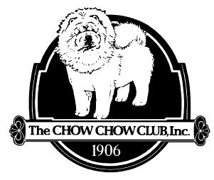
The Chow Chow
Presentation Produced by the
Chow Chow Club, Inc.
Updated 09/19/2025

Slide 2
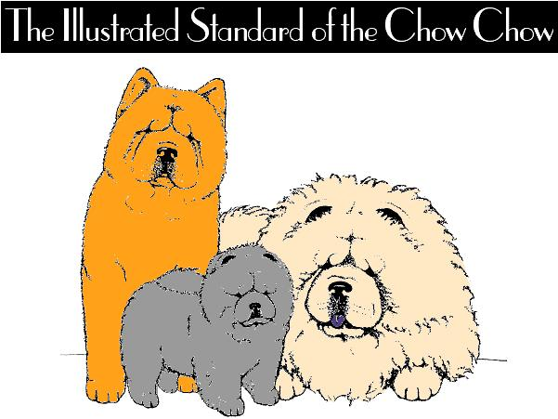
Can be viewed online at www.chowclub.org

Slide 3
INTRODUCTION

Slide 4
Brief History
Among the most ancient of breeds, “referenced as far back as 1100 BC” (1).
Domesticated originally by the ancestors of the Mongols (2).
Considered to have working origins – “war, hunting, herding, pulling and protection of the home”.
Commonly kept as guard dogs in the ancient monasteries – stories abound of the ancient lines of sacred pure blue Chows (1) (2).
Around 1780 - First imported to England (1) (2).
Mid 1890s - Imported to America
1906 – The Chow Chow Club, Inc. is formed.
The Chow Chow, Green, Honor K-R Books, 1975.
The Chow Chow; Collett, C. E., Arco Pub. Co., 1972.

Slide 5
CHARACTERISTICS

Slide 6
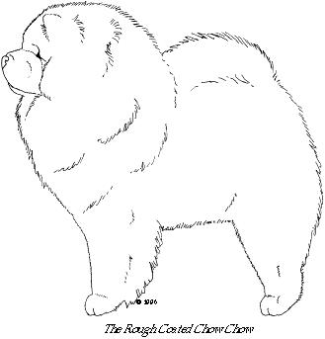
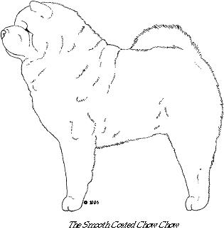
An ancient breed of northern Chinese origin, this all-purpose dog of China was used for hunting, herding, pulling and protection of the home.
*While primarily a companion today, his working origin must always be remembered when assessing true Chow type.

Slide 7
Essence of the Breed
Essentials of Breed Type
A Spitz breed – double coated, prick ears, tail over the back
Square proportions
Blue/Black Tongue
Straight rear and stilted gait
Scowling expression
Aloof temperament

Slide 8
GENERAL APPEARANCE

Slide 9
A powerful, sturdy, squarely built, upstanding dog of Arctic type, medium in size with strong muscular development and heavy bone.
The body is compact, short coupled, broad and deep, the tail set high and carried closely to the back, the whole supported by four straight, strong, sound legs.

Slide 10
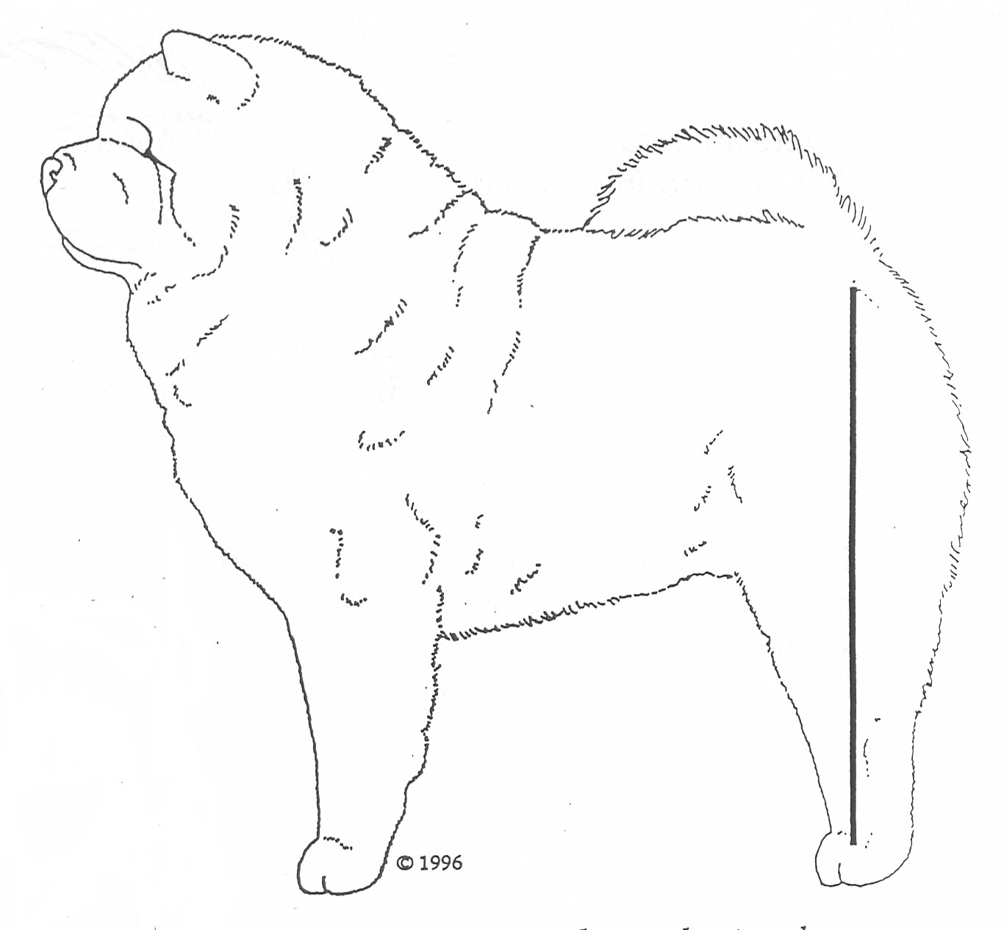
Viewed from the side, the hind legs have little apparent angulation and the hock joint and metatarsals are directly beneath the hip joint.
It is this structure which produces the characteristic short, stilted gait unique to the breed.

Slide 11
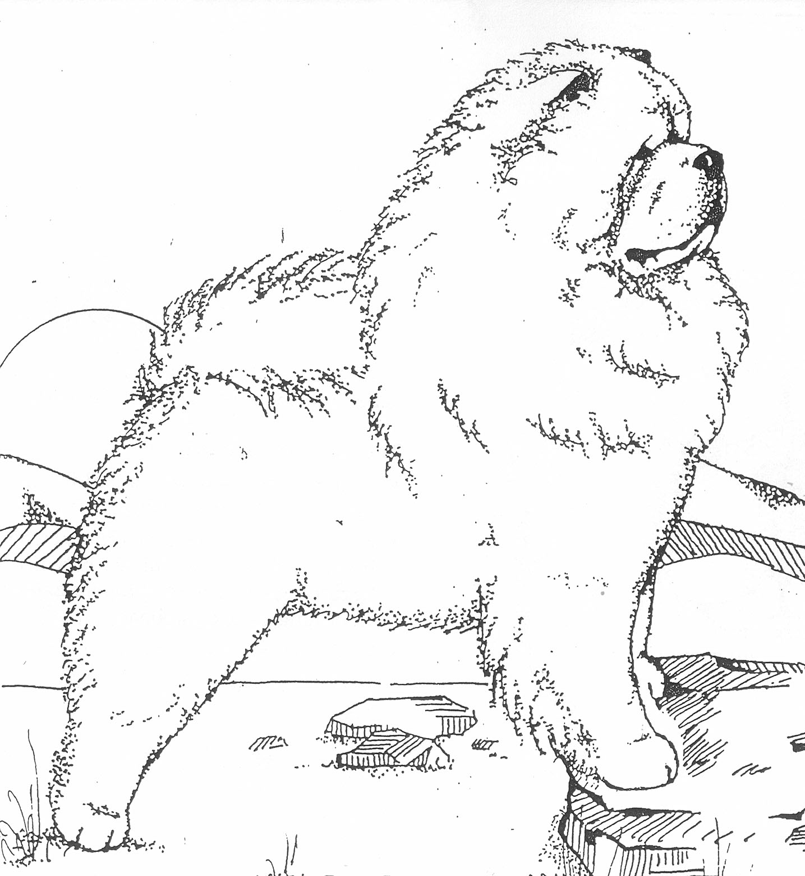
The large head with broad, flat skull and short, broad and deep muzzle is proudly carried and accentuated by a ruff.
Elegance and substance must be combined into a well balanced whole, never so massive as to outweigh his ability to be active, alert and agile.

Slide 12
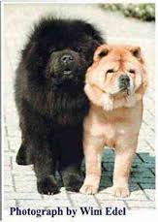
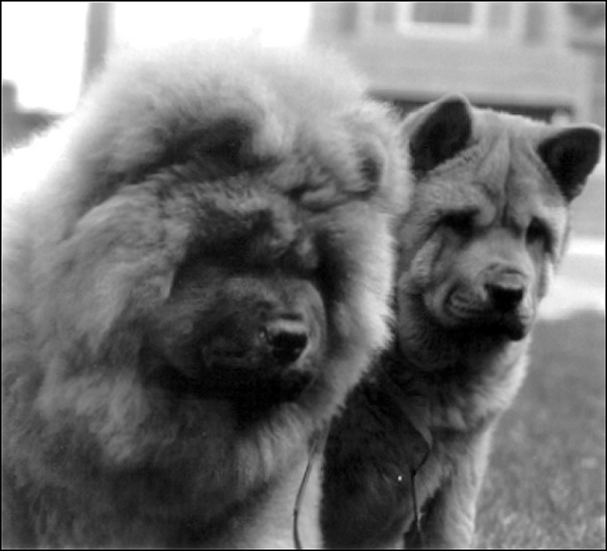
Clothed in a smooth or an off standing rough double coat,
the Chow is a masterpiece of beauty,
dignity and naturalness,
unique in his blue-black tongue, scowling expression and stilted gait.

Slide 13
SIZE,
PROPORTIONS,
& SUBSTANCE

Slide 14
Substance
Medium in size
With strong muscular development,
And heavy bone.
Equally objectionable are;
Fine boned specimens,
And overdone, ponderous cloddy specimens.
In comparing specimens of different sex
Due allowances must be made in favor of bitches who may not have as much head or substance as do the males.
There is an impression of femininity in bitches as compared with an impression of masculinity in dogs.

Slide 15
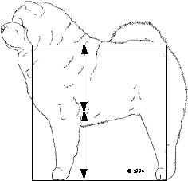
Size vs. Proportions
X
The average height of adult specimens
is 17 to 20 inches at the withers,
but, in every case, consideration of
overall proportions and type
should take precedence over size.

Slide 16
Proportions
Square in profile & close coupled.
Distance from forechest to point of buttocks,
Equals height at the highest points of the withers.
Serious Fault;
Profile other than square.

Slide 17
Proportions
*Floor of the chest level with tips of elbows.
*Distance from tip of elbow to ground
is half the height at the withers

Slide 18


Proportions
Width viewed from the front and rear is the same and must be broad.

Slide 19
Proportions
It is the aforementioned proportions that are essential to true Chow type.
In judging puppies,
no allowance should be made for their failure to conform to these proportions.

Slide 20
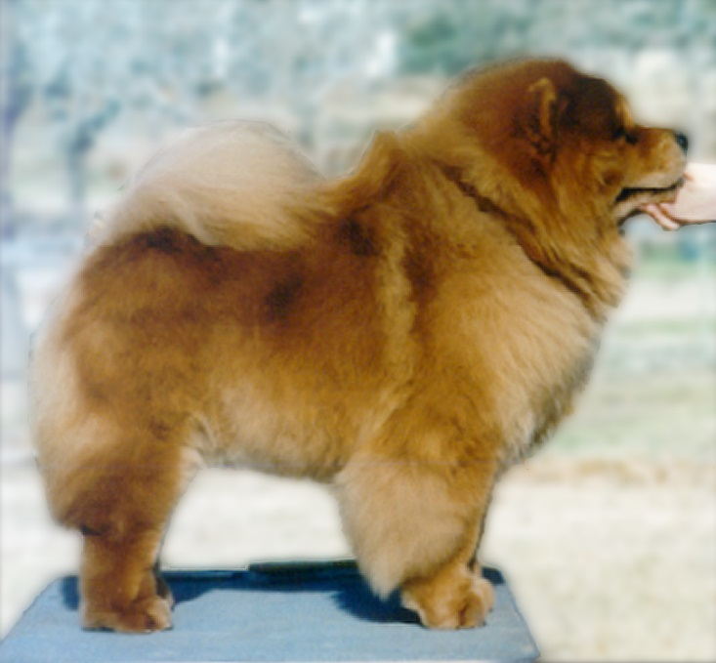
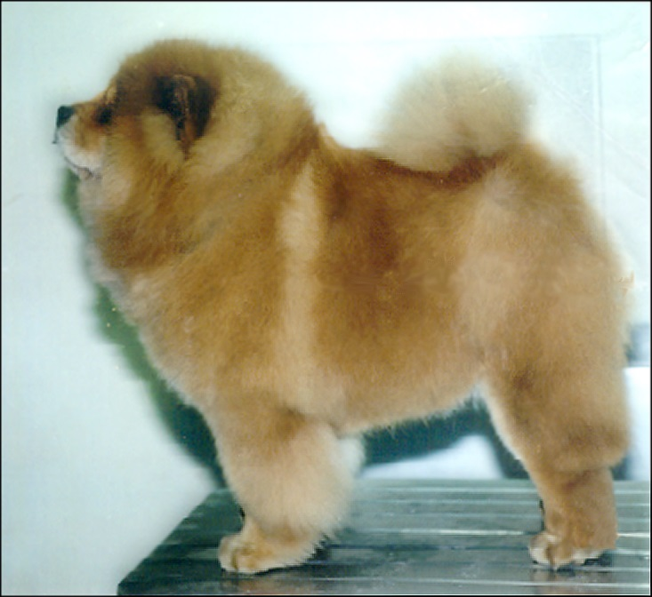
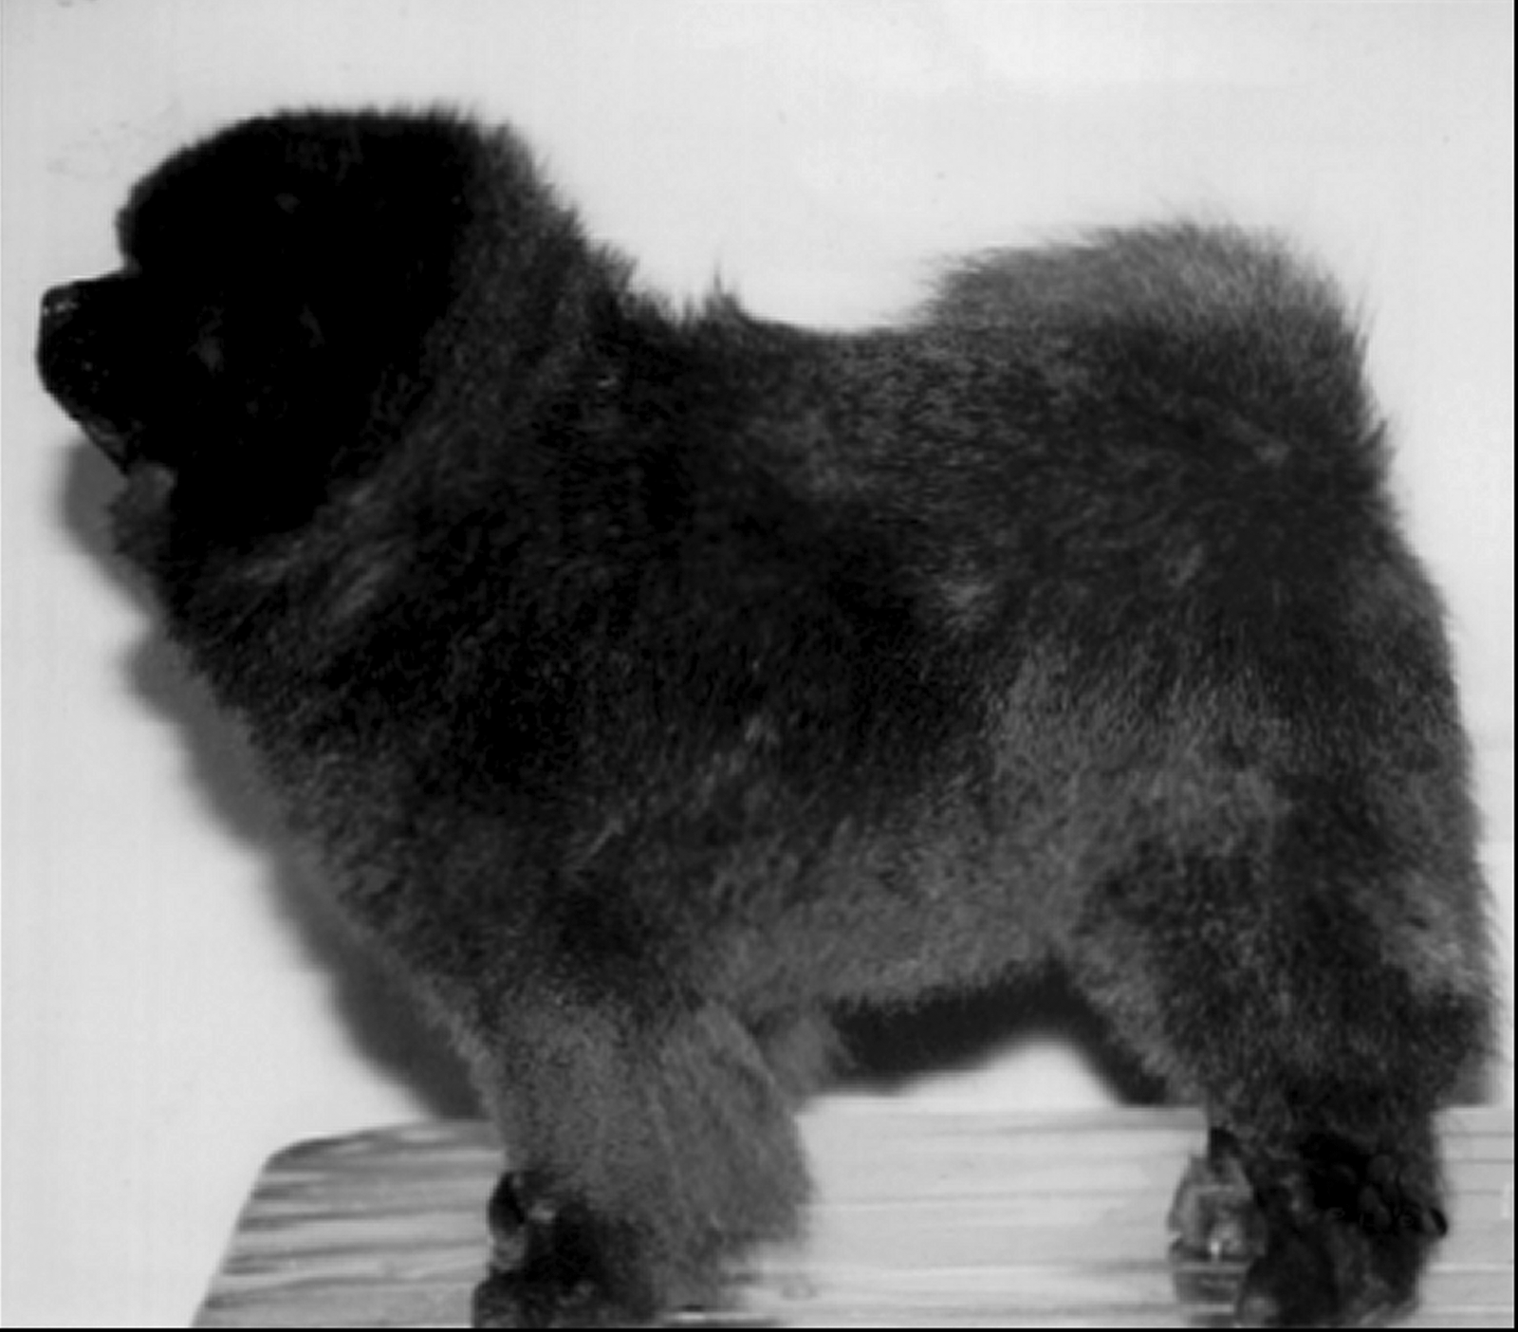
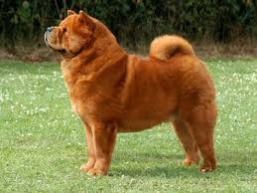
Proportions;
Correct length of leg,
True Chow type
Dog
Bitch
Dog
Bitch

Slide 21
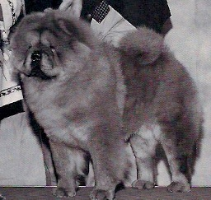
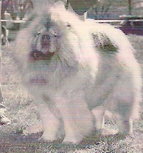
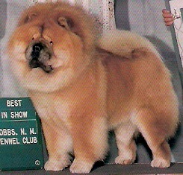
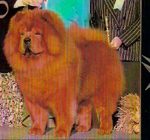
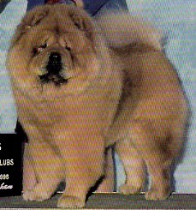
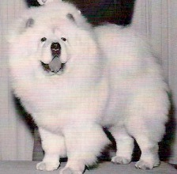
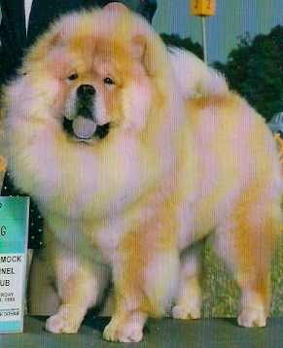
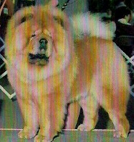
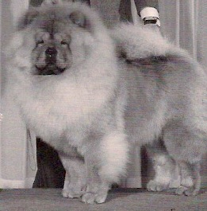
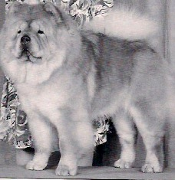
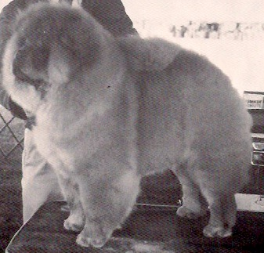
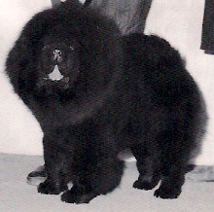
Proportions;
Correct length of leg,
True Chow type

Slide 22
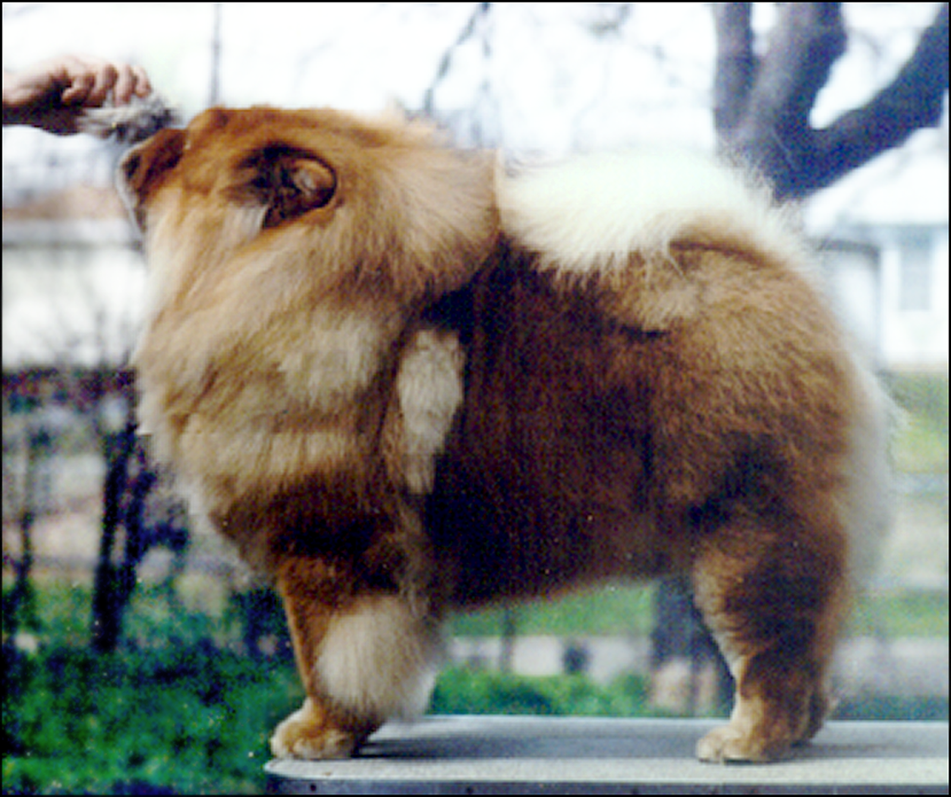
Incorrect proportion
Too long in body and loin

Slide 23
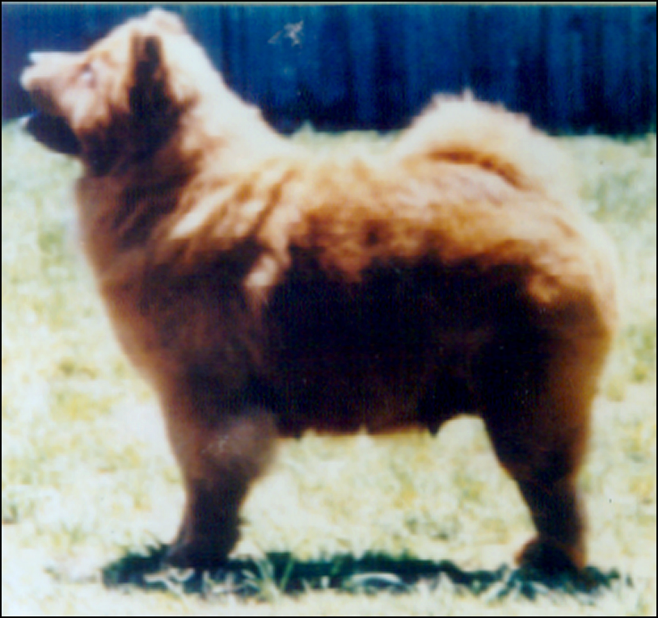
Incorrect proportions too long in body and loin too small in head and bone

Slide 24
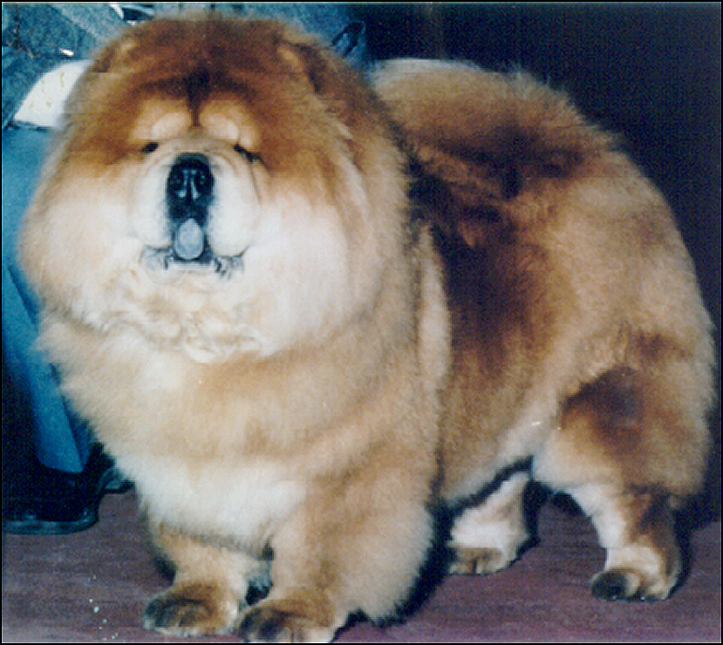
Incorrect proportions too long in body and loin overdone, cloddy, ponderous

Slide 25
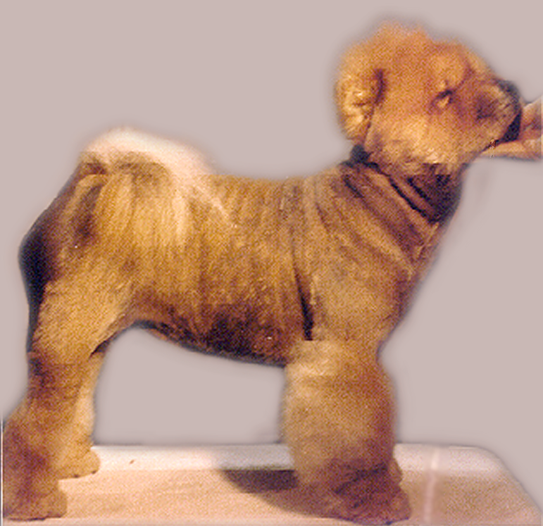
Chow Chow shaved down to show actual body structure
Correct topline – short, level back, good depth of chest

Slide 26
HEAD

Slide 27
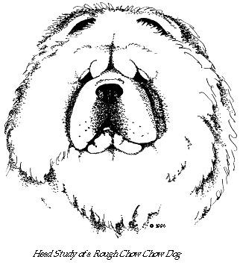
Expression
Essentially scowling, dignified, lordly,discerning, sober and snobbish, one of independence.
The scowl is achieved:
by a marked brow with a padded button of skin just above the inner, upper corner of each eye,
by sufficient play of skin to form frowning brows and a distinct furrow between the eyes beginning at the base of the muzzle and extending up the forehead,
by the correct eye shape and placement,
by the correct ear shape, carriage and
placement.
NOTE:
Excessive loose skin is not desirable. Wrinkles on the muzzle do not contribute to expression and are not required.

Slide 28
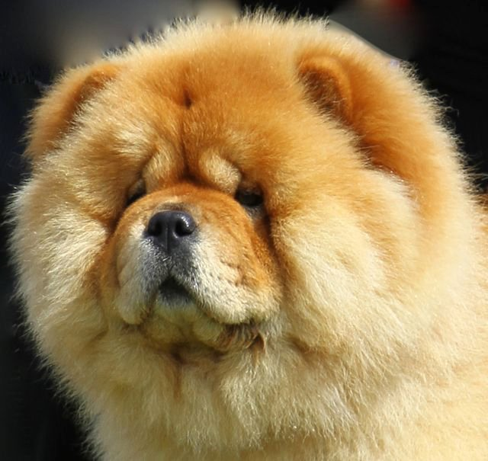
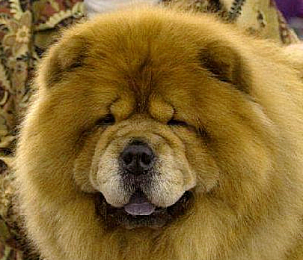
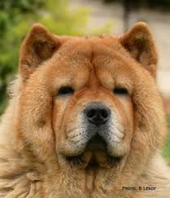
Correct expression
Rough bitch
Rough male Smooth male

Slide 29
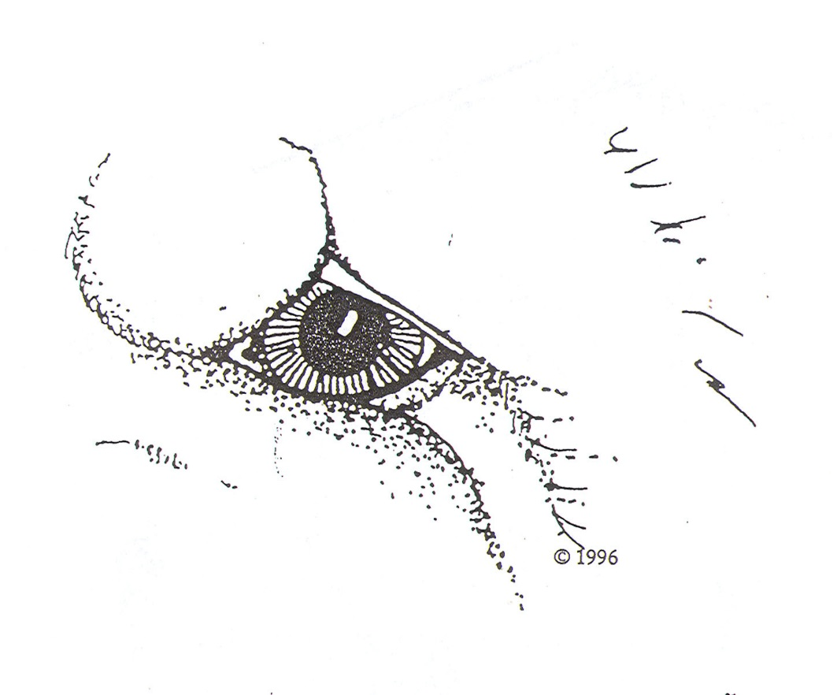
Eyes
Dark Brown.
Deep set and placed wide apart.
Almond in shape.
Eye rims black.
Lids that neither turn in nor droop.
Pupils of the eyes clearly visible.
The correct placement and shape should create an Oriental appearance.
Serious Faults
-Entropion or Ectropion-
-Pupils wholly or partially obscured by loose skin-

Slide 30
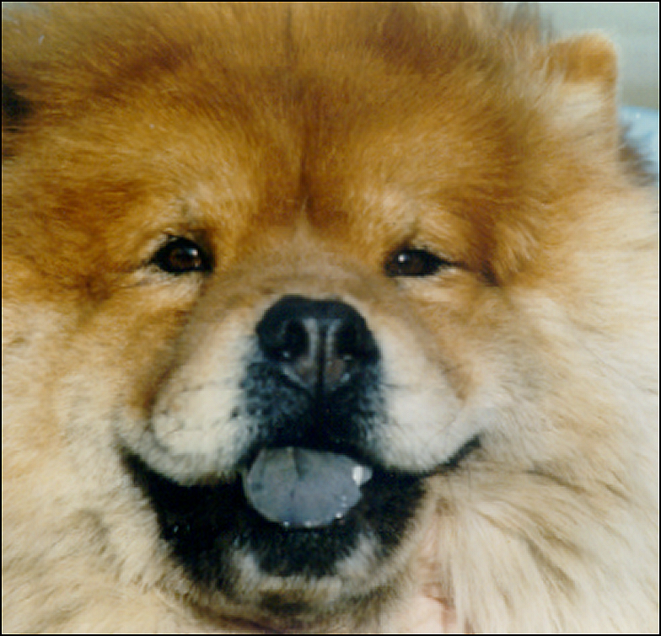
Correct almond-shaped, obliquely set eyes

Slide 31
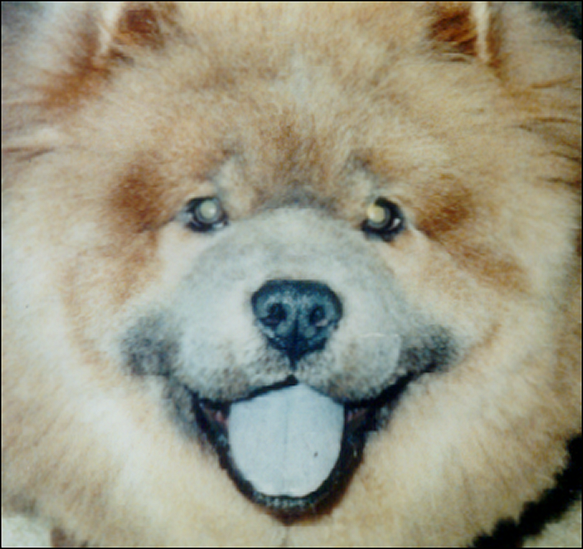
Incorrect expression
Incorrect round eyes
Rough male

Slide 32
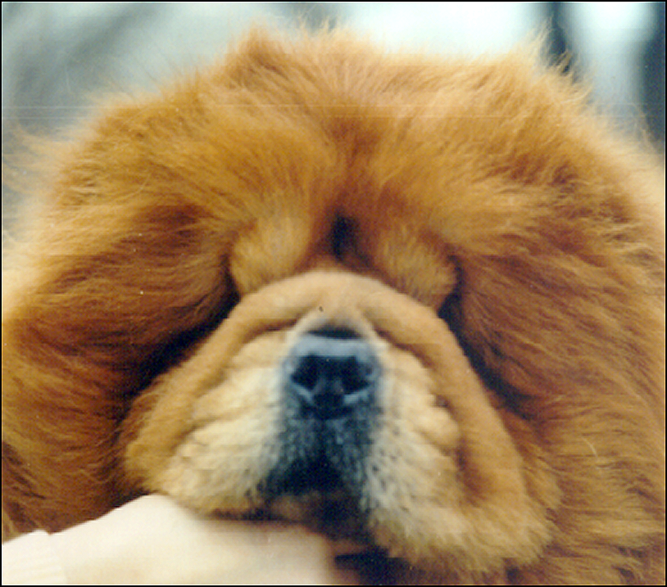
Excessive loose skin and padding vertical wrinkles allow skin to fold in over the eyes

Slide 33
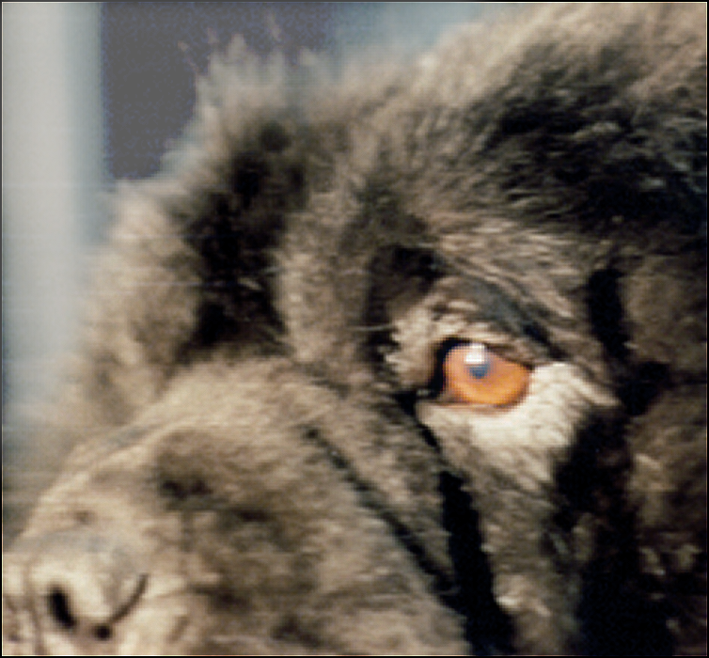
Eyes too light in color

Slide 34
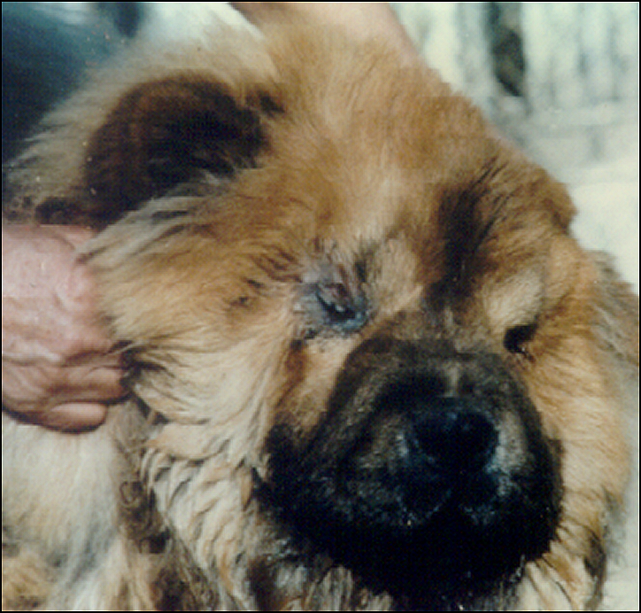
Eyes too deep allowing skin to fold into eye socket

Slide 35
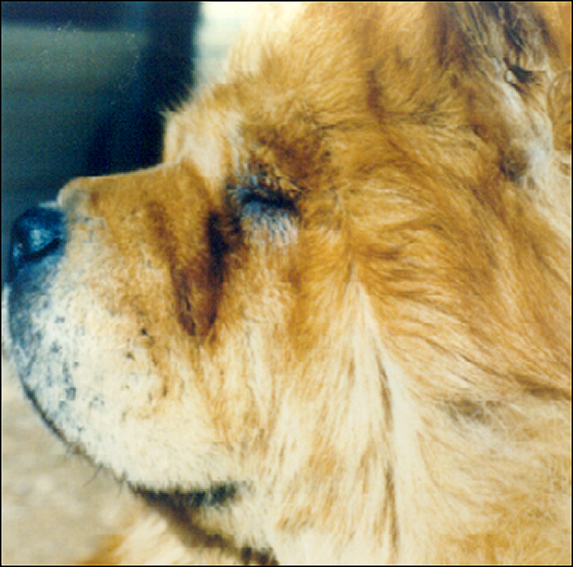
Entropion involving upper and lower lids

Slide 36
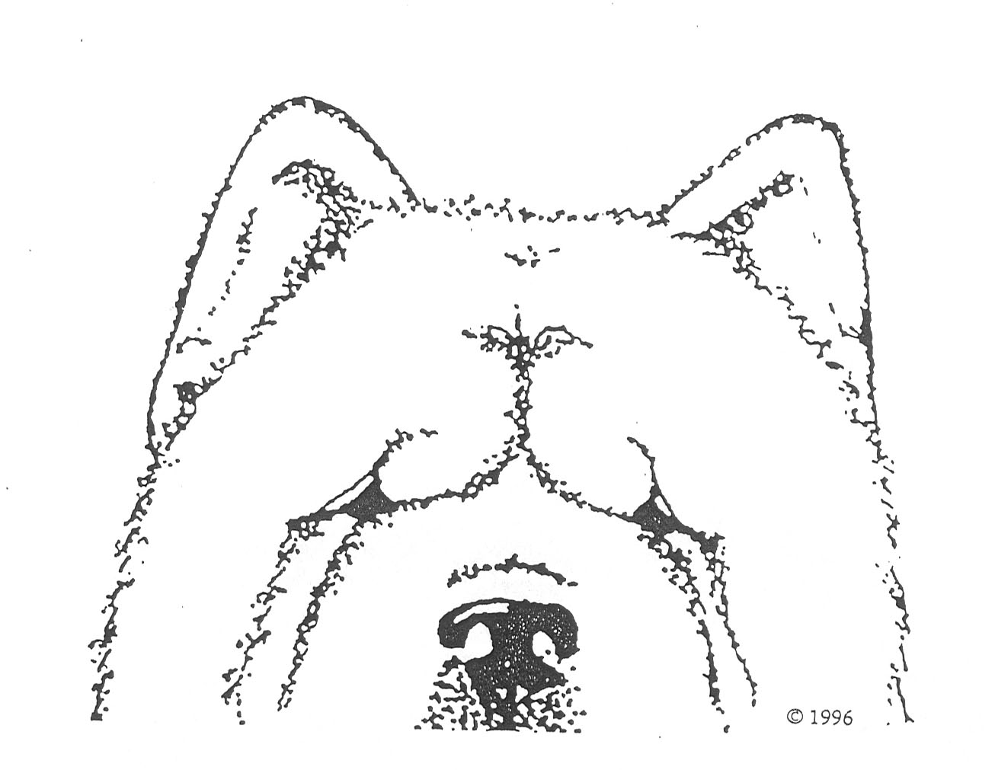
Ears
Small
Moderately thick
Triangular in shape
Slight rounding at the tip
Carried stiffly erect
With slight forward tilt
Placed wide apart
Inner corner on top of the skull
An ear that flops as the dog moves is highly undesireable
DISQUALIFYING FAULT
Drop ear or ears.
A Drop Ear is one which breaks at any point from its base to its tip or which is not carried stiffly erect, but, lies parallel to the top of the skull.

Slide 37
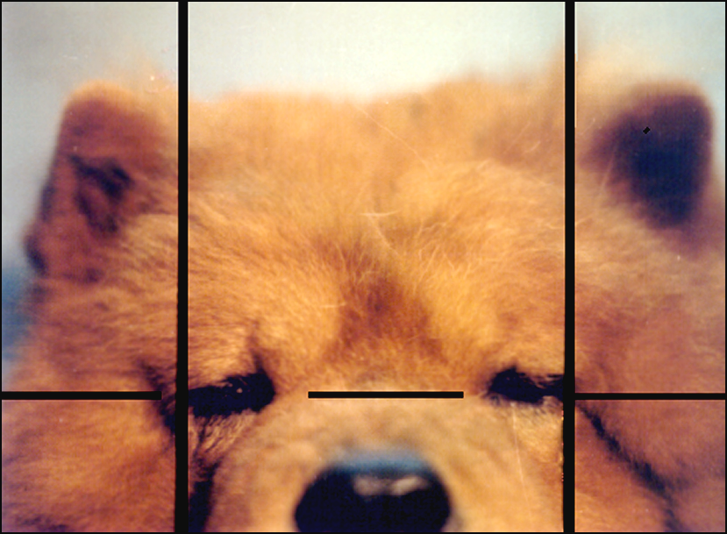
Correct alignment of eyes and ears essential to correct expression

Slide 38
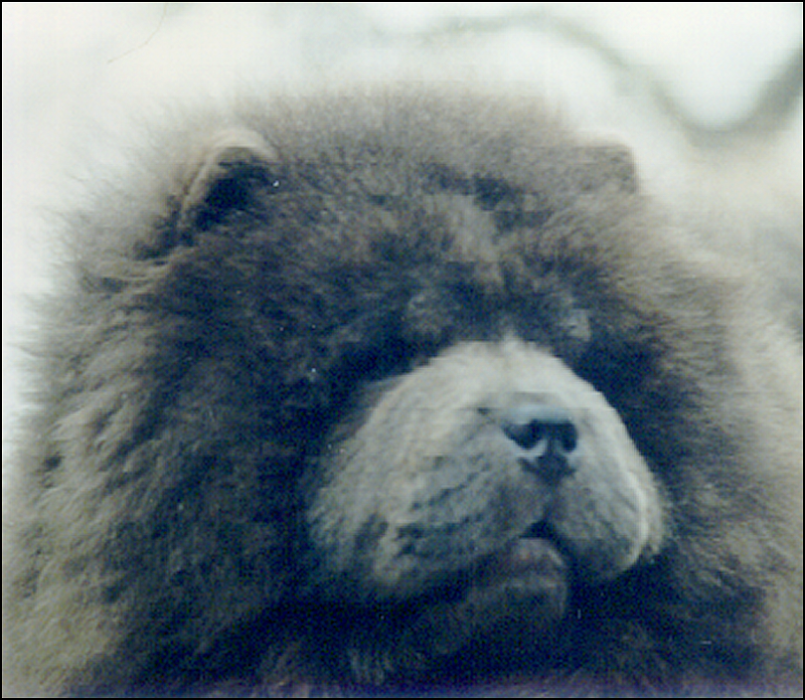
Small ears correctly set

Slide 39
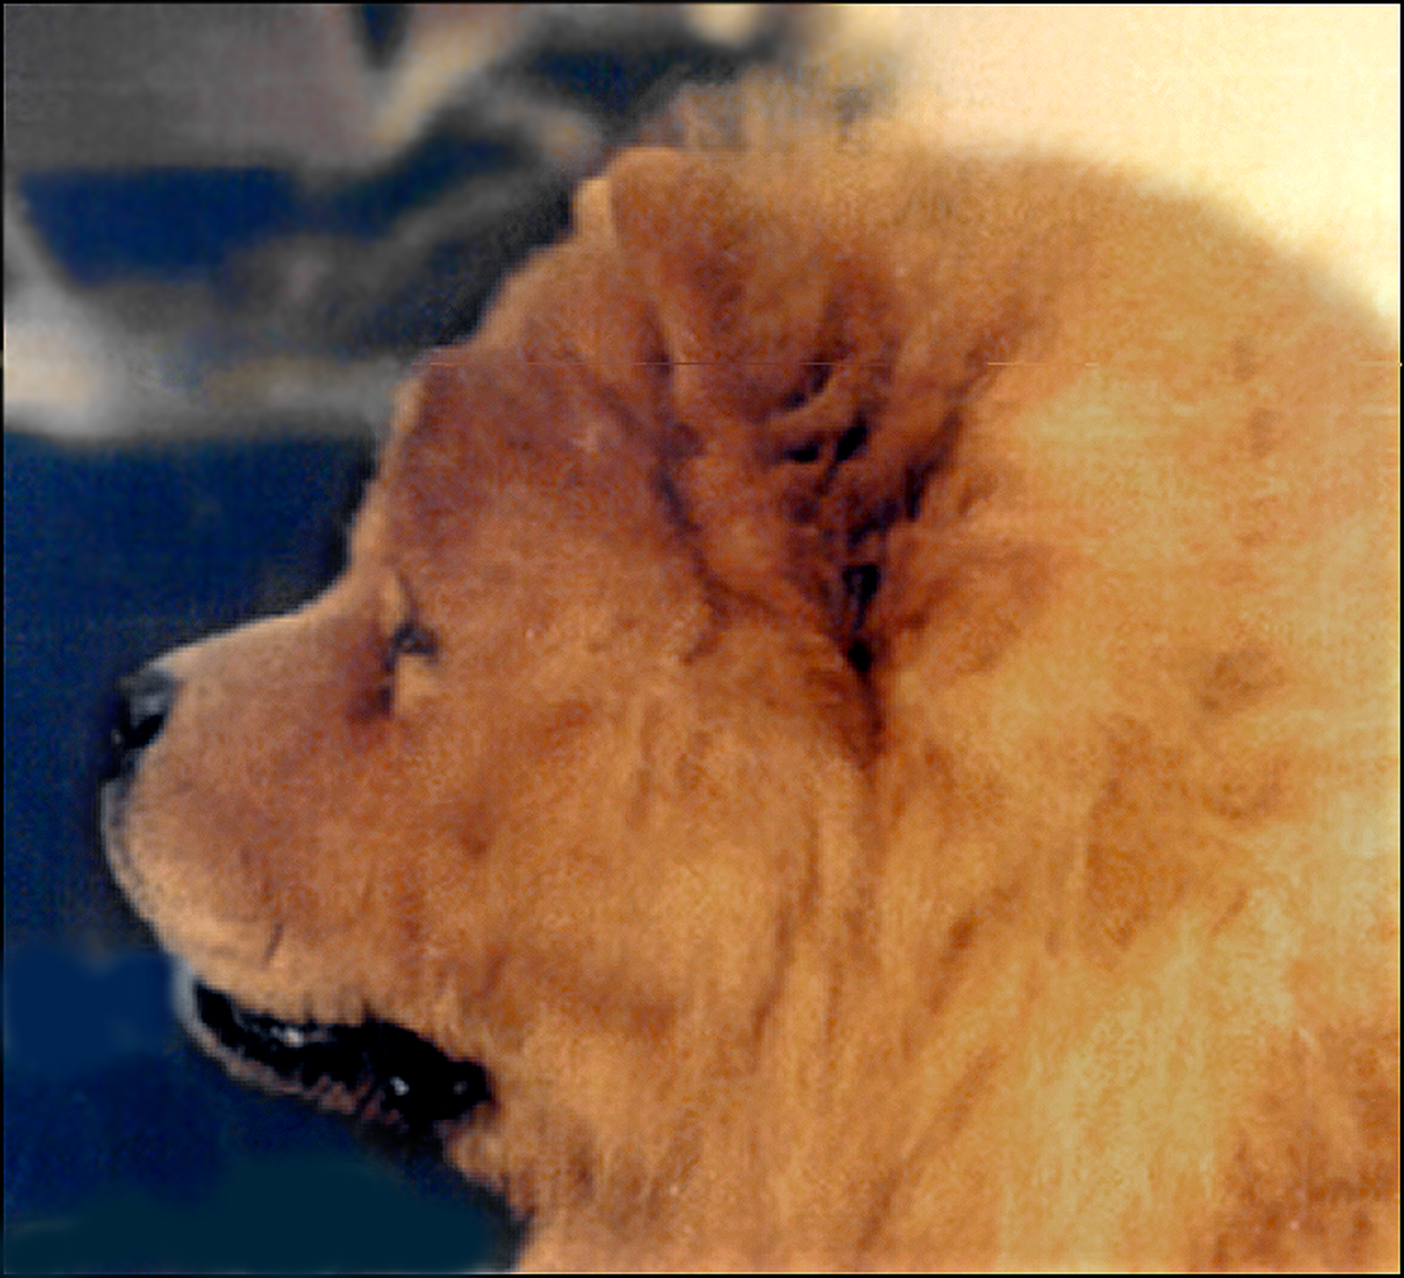
Ears with correct forward tilt

Slide 40
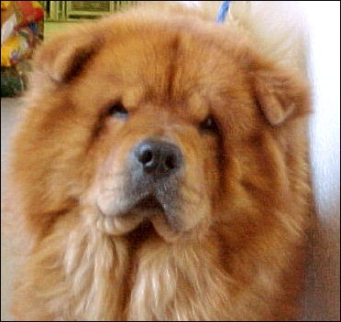
Disqualifying fault: dropped ears

Slide 41
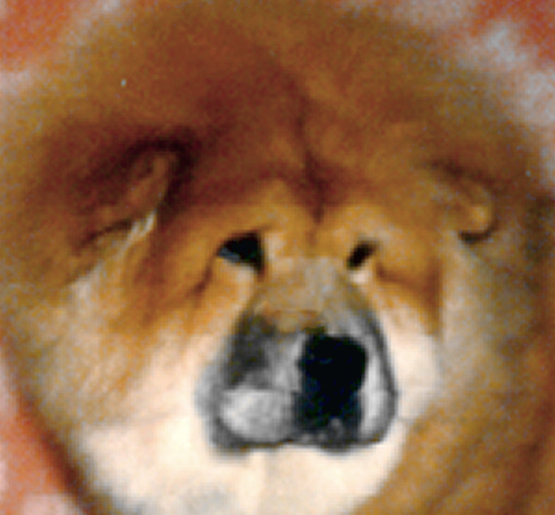
Incorrect ears; too large, set too low, too wide apart, tilted too far forward

Slide 42
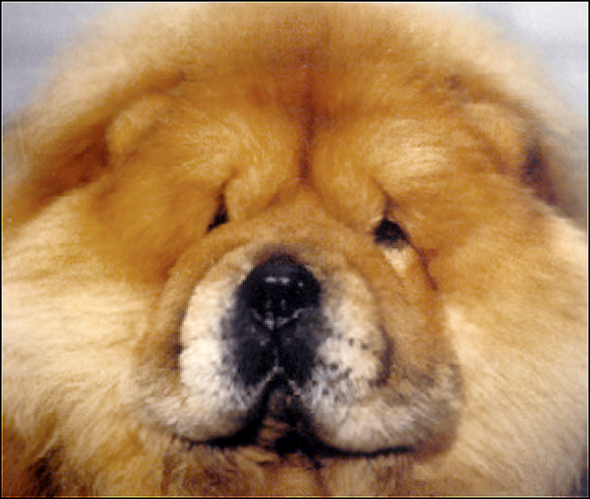
Incorrect ears; too large, set too low, should point upward, not outward

Slide 43
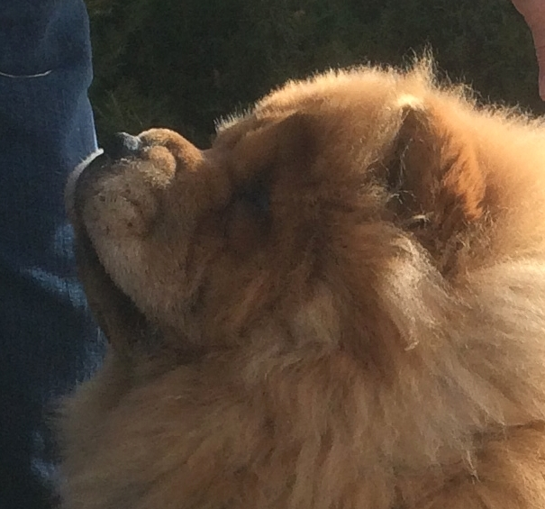
Ears in correct position

Slide 44
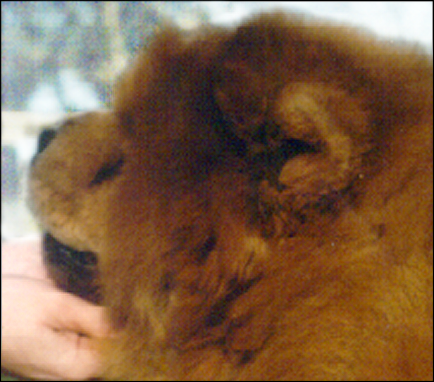
Rotating ears making them appear to be incorrectly set

Slide 45
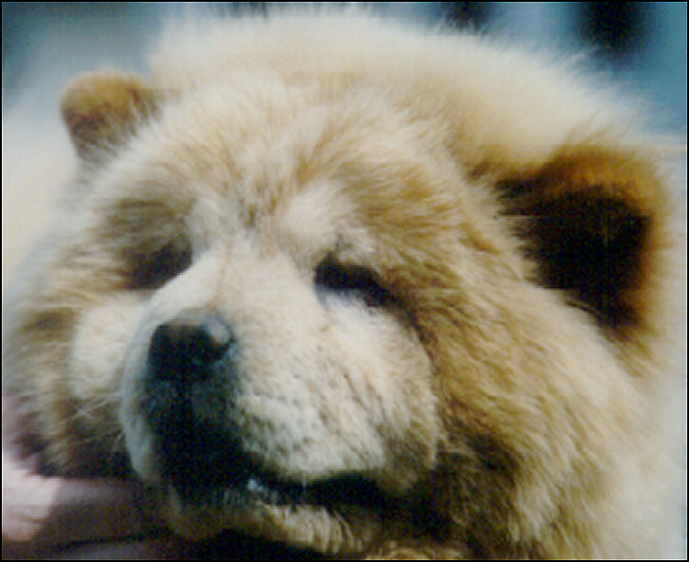
Another example of an “ear trick”

Slide 46

Head, Skull & Stop
Proudly carried,
Large in proportion to the size of the dog,
Never so exaggerated as to make the dog seem top-heavy,
Or to result in a low carriage.
Topskull is broad and flat from side to side and front to back.
Coat and loose skin cannot substitute for correct bone structure.
Viewed in profile, the toplines of the muzzle and skull are approx. parallel, joined by moderate stop.
Padding of brows may make the stop appear steeper than it is.

Slide 47

Correct skull; topline of the muzzle appears parallel to topline of the skull

Slide 48

Incorrect skull: too narrow, falls off at the sides
Incorrect expression; eyes too round

Slide 49
Incorrect; visible downward deviation of the muzzle resulting in a down-faced appearance

Slide 50

Muzzle
Short in comparison to the length of the topskull.
Never less than 1/3 of the head length.
Broad and well filled out under the eyes.
Width and depth are equal,
Both dimensions should appear to be the same from its base to its tip.
Square appearance is achieved by correct bone structure…
Plus padding of the muzzle and full cushioned lips.
Should never be so padded or cushioned as to make it appear other than square.
Upper lips completely cover the lower lips when the mouth is closed but should not be pendulous.

Slide 51

Incorrect muzzles

Slide 52
Nose
Large
Broad
Black in color
Well opened nostrils
DISQUALIFYING FAULT
Nose spotted or distinctly other color than black, except in blue chows which may have solid blue or slate noses and cream chows which may have a nose with a range of color.

Slide 53
Blue Chow Chow with slate nose

Slide 54



Cream Chow Chow – Cream chows may have a range of nose color, from dark black/brown solid pigment, fading to pinkish pigment, with or without darker nose rim pigment at the outer edge, as puppies or adults; all of which are equally correct.

Slide 55
Mouth and Tongue
Edges of the lips black
Tissues of the mouth mostly black
Gums preferably black
A solid black mouth is ideal
Top surfaces and edges of the tongue a solid blue-black
The darker the better.
DISQUALIFYING FAULT
The top surface or edges of the tongue red or pink or with one or more spots of red or pink.

Slide 56

Correct blue-black tongue pigment

Slide 57


There may be pink on the underside of the tongue. You need only examine the surface and edges of the tongue.

Slide 58

Mouth, lips and gums blue-black

Slide 59

Pink gums are acceptable although solid blue-black is preferred

Slide 60
Teeth
Strong
Even
Scissors bite

Slide 61
Summary of the Head
DQ’s; nose pigment, tongue pigment and dropped or broken ear/s.
Serious Deviations;
Small, narrow or rounded topskull; narrow, long muzzle.
Head appearing top-heavy or carried low.
Muzzle other than square.
Head or muzzle triangular in appearance.
Tongue pigment very light.
Defects in the eyes
Eyes surrounded by loose skin.
Entropion or ectropion.

Slide 62
NECK,
TOPLINE,
& BODY

Slide 63

Neck
Strong
Full
Well-muscled
Nicely arched
Of sufficient length to carry the head proudly above the topline when standing at attention.

Slide 64
Correct length and arch of neck
Smooth male

Slide 65


Correct length and arch of neck

Slide 66

Incorrect; neck too short

Slide 67

Body
The correct chest and topline. Note again
the equal, balanced proportions.
Short
Compact
Close coupled
Strongly muscled
Broad & deep
Well let down in the flank

Slide 68
Body/
Chest
Broad, deep and muscular
Never narrow or slab sided
Ribs well sprung, not barrel.
Rib spring narrows somewhat at lower ends to permit shoulder and upper arm to fit smoothly against chest wall.
Chest floor is broad & deep extending down to the tips of the elbows
Point of sternum slightly in front of the shoulder points.
SERIOUS FAULTS
Labored or abdominal breathing [not to include normal panting]
Narrow or slab-sided chest.

Slide 69


Correct broad chest
Male Female
Male
Female

Slide 70

Incorrect; narrow chest

Slide 71
Topline; Loin, Croup
Topline;
Straight
Strong
Level
From the withers to the root of the tail.
Loin;
Well muscled
Strong
Short
Broad and deep
Croup;
Short and broad
W/ a powerful rump and thigh muscles
Giving a level croup
The correct chest and topline. Note again
the equal, balanced proportions.

Slide 72
TAIL

Slide 73


Tail
Set high.
Carried closely to the back at all times.
Following the line of the spine at the start.

Slide 74

Incorrect loose tail
Correct tail

Slide 75
FOREQUARTERS

Slide 76

Forequarters
Shoulders strong, well muscled
Tips of shoulders moderately close
Spine of shoulder forms approx. 55 deg. angle with horizontal.
Spine of shoulder forms an approx. 110 deg. angle with the upper arm.
Resulting in less reach of the forelegs.
Length of upper arm never less than length of shoulder blade.
Elbows set well back alongside the chest wall
Elbows turning neither in nor out.

Slide 77

Correct forequarters

Slide 78

Incorrect; legs too far forward

Slide 79

Forelegs
Perfectly straight from elbow to foot
Heavy bone which must be in proportion to the rest of the dog.
Viewed from the front…parallel and widely spaced to commensurate the wide chest.
Pasterns short and upright
Wrists shall not knuckle over.
Dewclaws may be removed.

Slide 80
Incorrect; bone too light for size of the dog

Slide 81
Incorrect; bone too large, large splayed feet

Slide 82
FEET

Slide 83

Round
Compact
Catlike
Standing well upon the thick toe pads.

Slide 84



Correct compact catlike feet

Slide 85

Incorrect splayed, flattened feet

Slide 86
HINDQUARTERS

Slide 87

Rear Assembly
Broad.
Powerful.
Well muscled in the hips and thighs.
Heavy in bone .
Rear and front bone approximately equal.
Viewed from the rear, the legs are straight, parallel, & widely spaced commensurate with the broad pelvis.
Dewclaws may be removed.
Feet same as the front.

Slide 88
Stifle Joint
SERIOUS FAULT;
Unsound Stifle
Shows little angulation
Is well knit and stable
Points forward
Bones of the joint should be clean and sharp

Slide 89
Hock
Joint
SERIOUS FAULT;
Unsound Hock Joints
Well let down
Appears almost straight
Must be strong, well knit and firm
Never bowing, breaking forward or to either side.
The hock joint and metatarsal lie in a straight line below the hip joint.

Slide 90
Metatarsal
Short
Perpendicular to the ground

Slide 91




Correct hindquarters

Slide 92

Correct hocks and hindquarters

Slide 93

Correct hindquarter structure but lacking well muscled thigh

Slide 94

Sickle hocks

Slide 95

Incorrect hindquarters; legs set too far back

Slide 96
Chow Chow shaved down to show actual body structure

Slide 97
Coat

Slide 98

Rough or Smooth Coats
There are two types of coat: rough and smooth.

Slide 99
In the Rough Coat…
…the outer coat is abundant,
dense,
straight, and offstanding,
rather course in texture.
The under coat is soft,
thick,
and wooly.

Slide 100

Chow Chow puppy
Puppy coat soft, thick
and wooly overall

Slide 101
Chow Chow Coat
Puppy coat soft, thick and wooly overall.
The coat forms a profuse ruff around head and neck, framing the head.
The coat and rough generally longer in dogs than in bitches.
Tail is well feathered.
…coat length varies markedly on different Chows…
…thickness, texture and condition should be given greater emphasis than length.
Obvious trimming or shaping is undesirable.
Trimming of the whiskers, feet and metatarsals optional.

Slide 102
SMOOTH
The smooth coated Chow is judged by the same standard as the rough…
…except that references to the quantity and distribution of the outer coat are not applicable to the smooth coated Chow Chow…
…which has a hard, dense outer coat…
…with definite undercoat.
There should be no obvious ruff…
… or feathering on the legs and tail.

Slide 103

Good examples of rough and smooth Chow Chows

Slide 104
Coat Color
Clear colored, solid or solid with lighter shadings in the ruff, tail and featherings
There are five colors in the Chow;
*Red (light golden to deep mahogany),
*Black,
*Blue,
*Cinnamon (light fawn to deep cinnamon),
and *Cream.
Acceptable colors to be judged on an equal basis.

Slide 105




Coat Color
There are five colors;
Red (light golden to deep mahogany)
Black
Blue
Cinnamon (light fawn to deep cinnamon)
Cream.

Slide 106





Shading in Coat all 5 colors may have lighter shading in rough or smooth coats

Slide 107


Slide 108

Dark Coat on Puppies

Slide 109
GAIT

Slide 110


Proper Movement
Is the crucial test of proper conformation & soundness.
It must be;
Sound
Straight moving
Agile
Brief
Quick and powerful
Never lumbering

Slide 111
Side Gait
It is from the side that the unique stilted action is most easily assessed.
Rear leg moves up and forward from the hip in a straight stilted pendulum-like line w/a slight bounce in the rump.
Legs extend neither far forward nor far backward.
Hind foot has a strong thrust which transfers power to the body in an almost straight line due to minimal rear leg angulation.
To transmit this power efficiently to the front assembly, the coupling must be short and there should be no roll through the midsection.

Slide 112



From the Rear
Line of bone from hip joint to pad remains straight as the dog moves.
As speed increases the hind legs incline slightly inward.
Stifle joints must point in the line of travel…
…not outward, resulting in a bow-legged appearance…
…not hitching in under the dog.

Slide 113

From the Front
Line of bone from the shoulder joint to pad remains straight as the dog moves.
As speed increases the forelegs do not move in exact parallel planes…
…rather incline slightly inward.
Front legs must not;
Swing out in semicircles,
Nor mince
Or show an evidence of hackney action.

Slide 114

GAIT

Slide 115
TEMPERAMENT

Slide 116
Temperament
Keen Intelligence,
Independent Spirit,
And Innate Dignity,
Give the Chow an aura of Aloofness.
It is the Chow’s nature to be reserved and discerning with strangers.
Displays of aggression or timidity are unacceptable.

Slide 117


Never approach a
Chow from either of
these directions
Because of its deep set eyes, the Chow has limited peripheral vision and is best approached from the front.

Slide 118
SUMMARY

Slide 119
JUDGING THE CHOW CHOW
Faults shall be penalized in proportion to their deviation from the standard.
The overall picture is of primary consideration.
Exaggeration of any characteristic at the expense of balance or soundness shall be severely penalized.

Slide 120
TYPE
Should include;
General appearance
Temperament
The Harmony of all parts
Soundness, especially as seen as the dog is in motion.
There should be proper emphasis on movement which is the final test of the Chow’s conformation, balance and soundness.

Slide 121

DQ’s
Nose spotted or distinctly other color than black, except in blue chows which may have solid blue or slate noses and cream chows which may have a nose with a range of color.
The top surface or edges of the tongue red or pink or with one or more spots of red or pink.
Drop ear or ears. A drop ear is one which breaks at any point from its base to its tip or which is not carried stiffly erect but lies parallel to the top of the skull.

Slide 122
Serious Faults
Profile other than square
Entropion or ectropion
Pupils wholly or partially obscured by loose skin
Labored or abdominal breathing (not to include normal panting)
Narrow or slab-sided chest
Unsound stifle or hock joints

Slide 123
APPENDICES

Slide 124

Approximate dimensions

Slide 125

Skeletal Structure

Slide 126

Chow Chow Structure

Slide 127

Chow Chow Anatomy

Slide 128
Thank you!
The members
of the Chow Chow Club Inc.
sincerely appreciate your dedication
to understanding the standard
for the Chow Chow.

